Slide 1
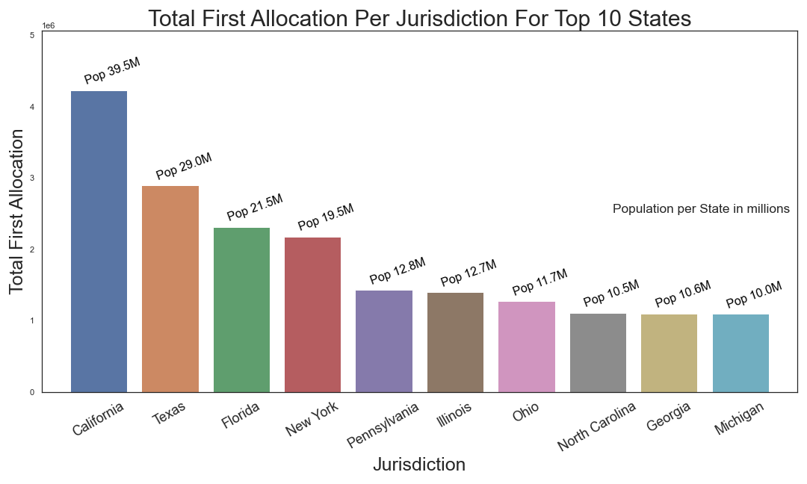
Pfizer and Moderna are vaccine supplers
From 12/14/2020 to 02/01/2021
Vaccine Allocation: California: 4,226,100; Taxas: 2,894,925; Florida: 2,313,050

Slide 2
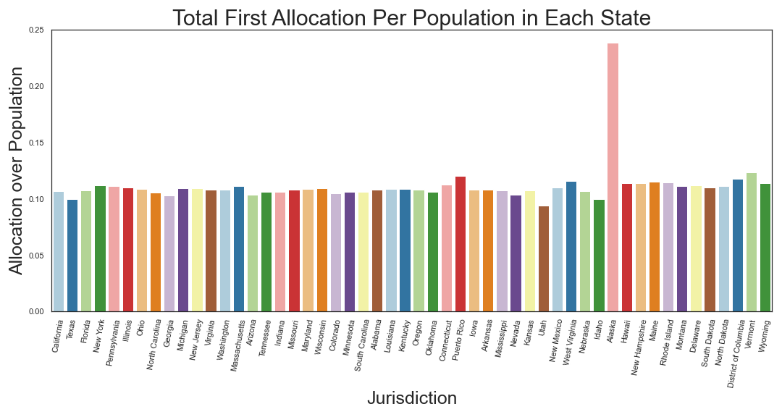

Slide 3
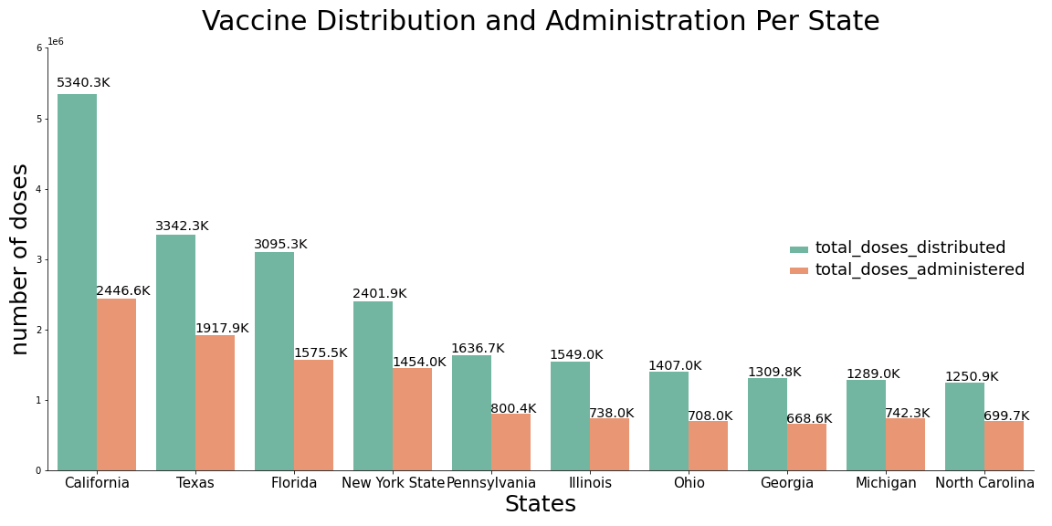
From 1/16 to 1/27
California got 5,340,275 distribution, but only 2,446,577 got administered

